Slide 1
DAMG 6210 - Data Management and Database Design
Roommate and Accommodation Management System
Group Number 9
Adarsh Suryavanshi - 002894722
Ashwatha E. S - 002308776
Pratik Kanade - 002311591
Priyank Bagad - 002338822
Sarthak Sargar - 002057385

Slide 2
Purpose
The primary purpose of ROOM & MATES is to revolutionize and upgrade the process of finding accommodation and preferred roommates by :
1. Simplifying the search process for both rooms and compatible cohabitants.
2. Reducing the time and effort required to find suitable living arrangements for available locations.
3. Finding accommodation with preferable roommates with each student's chosen filters.
4. Providing a secure and reliable platform for all aspects of the room search and roommate-matching process.
5. Ultimately, creating a more efficient, reliable and user-friendly solution to address the challenges of finding housing in desired locations and building connections in new environments.

Slide 3
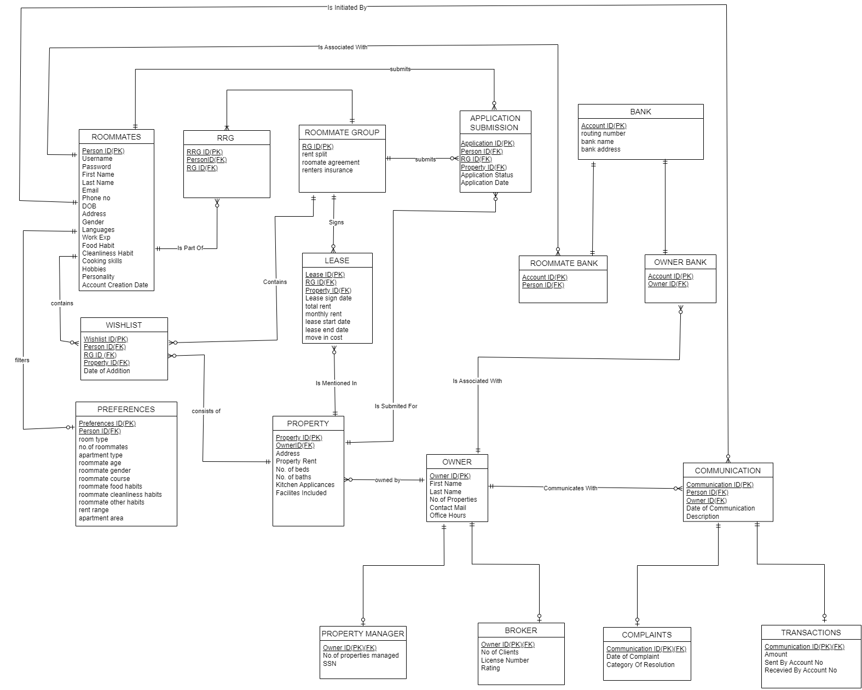
Entity - Relationship Diagram

Slide 4
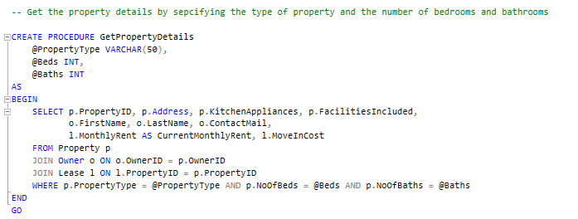
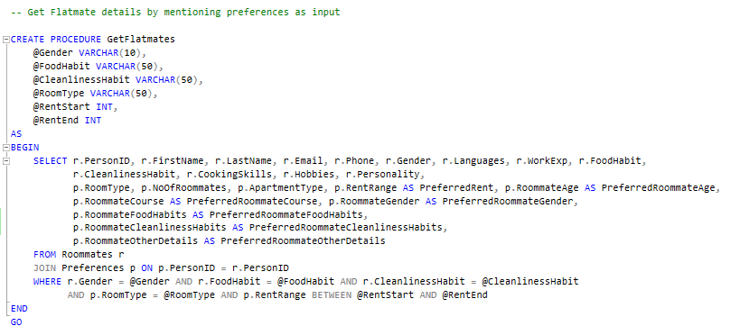
Stored Procedures

Slide 5
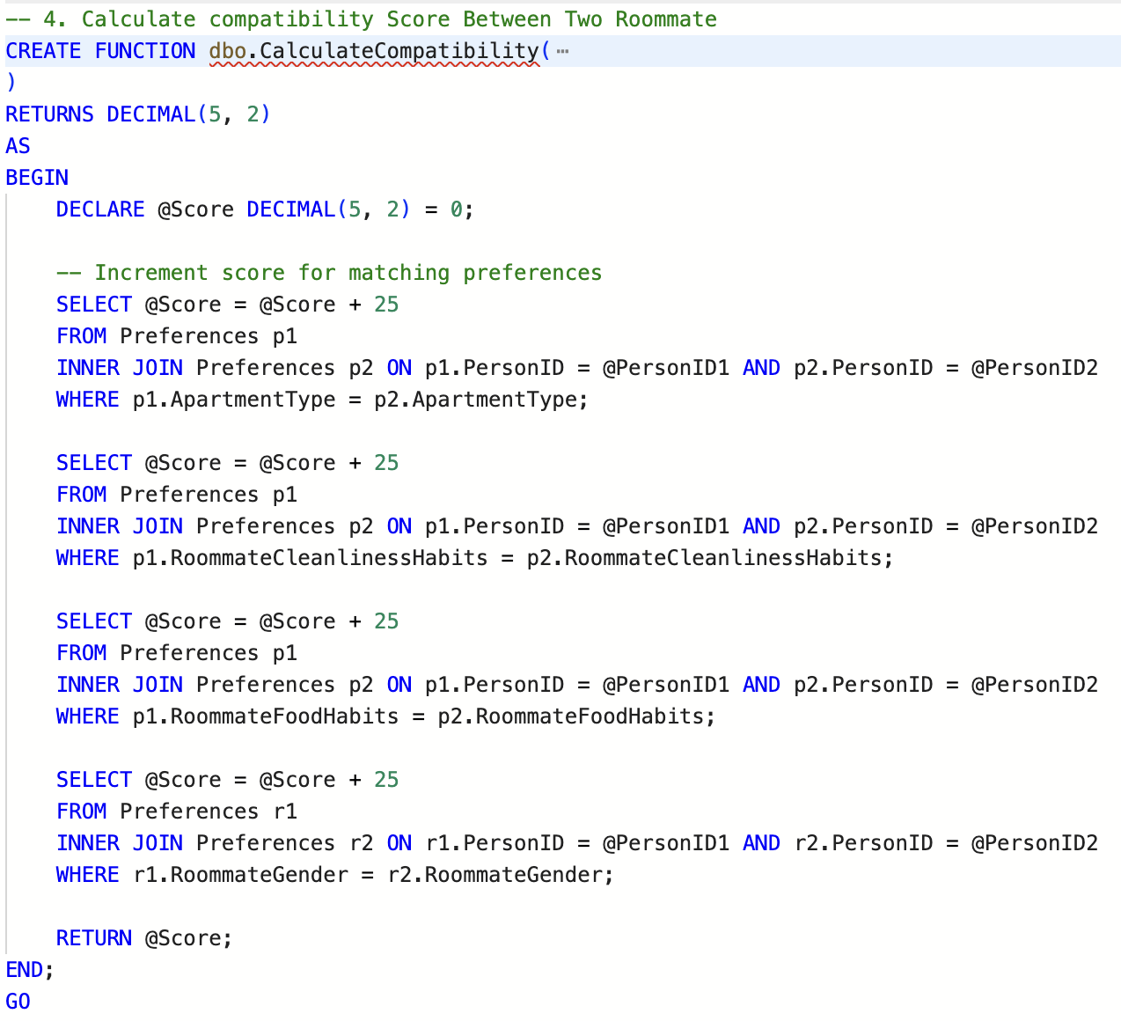
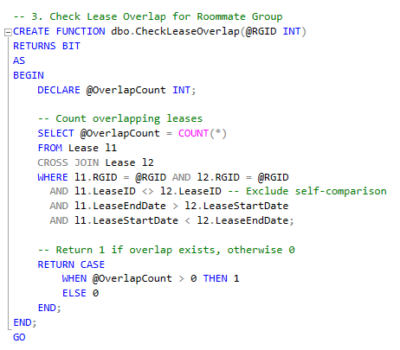
User Defined Functions

Slide 6
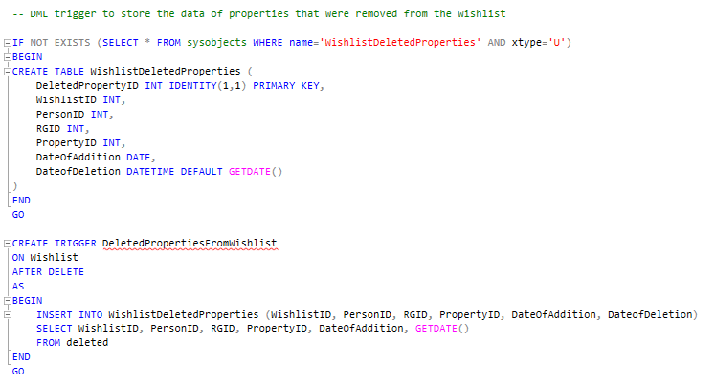
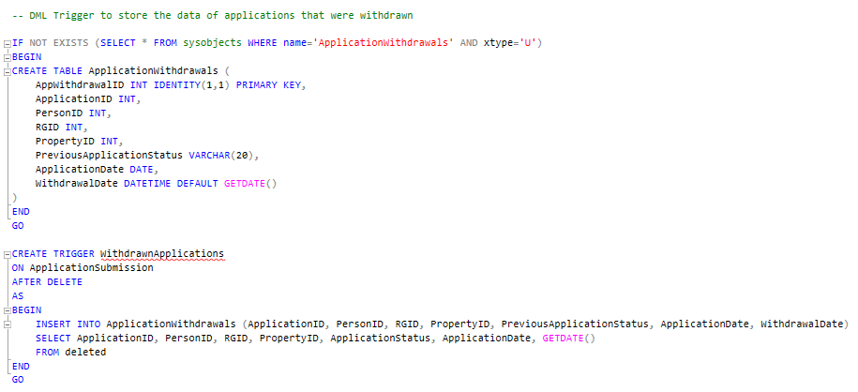
DML Triggers

Slide 7
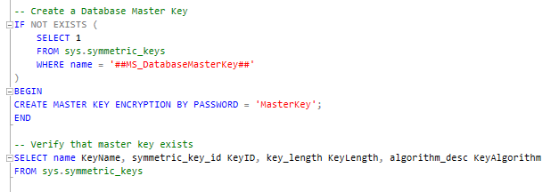
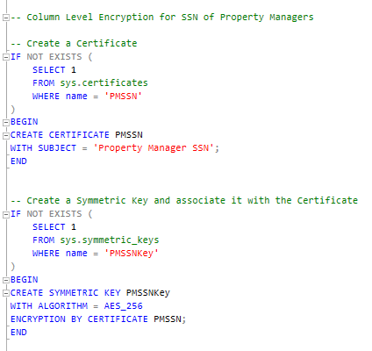
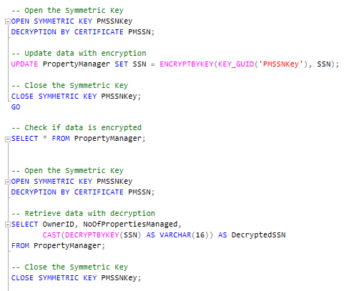
Data Encryption

Slide 8
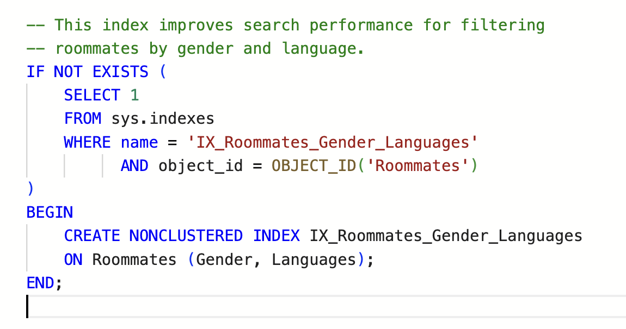
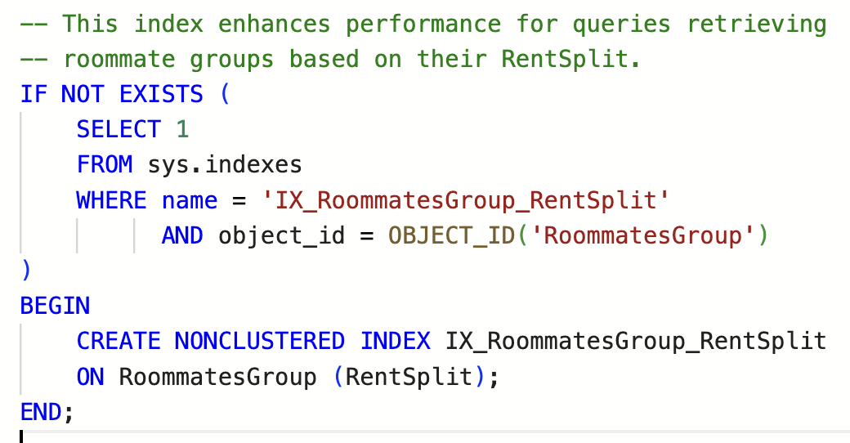
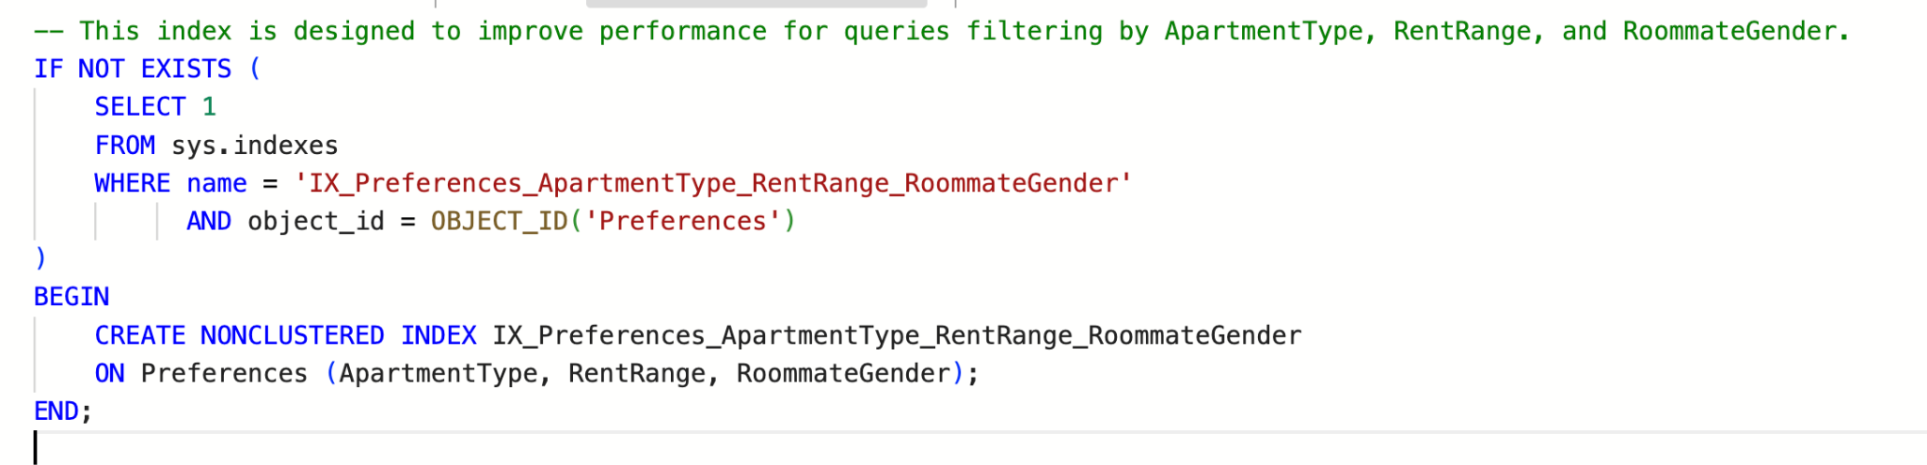
Non Clustered Index

Slide 9
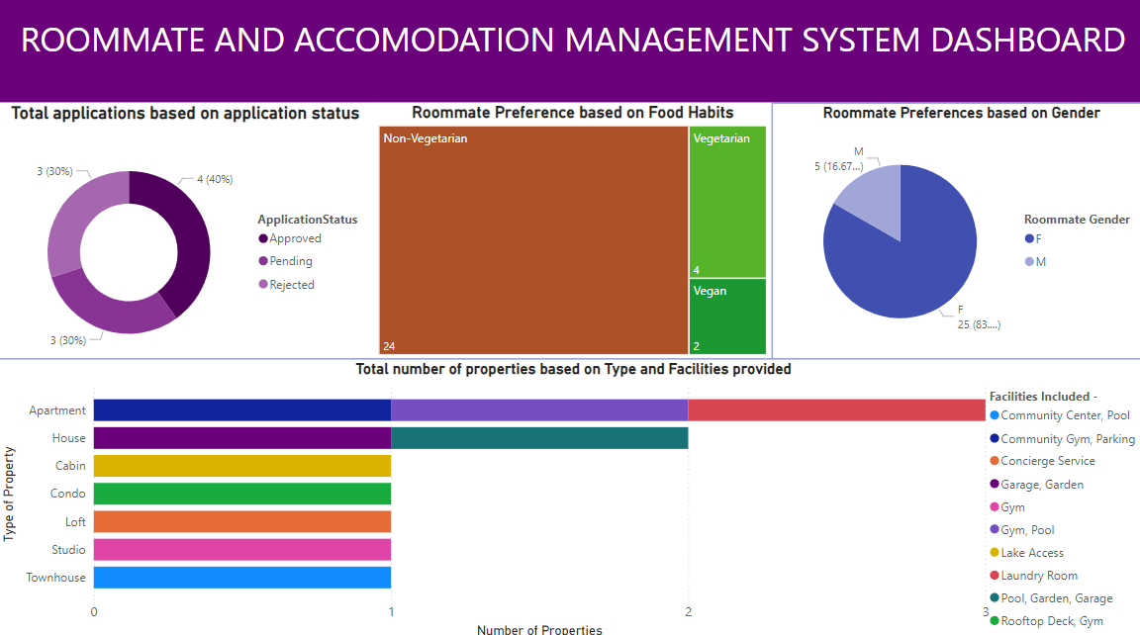
Power BI Report

Slide 10
Thank You

